Slide 1


Cricket Players
Performance System
(CPP)

Slide 2

Under the guidance of :
Project Team:
Arpita Agarwal
Anishlekha Joseph
Harsh Dogra
Namrata Gavhane
Pariniti Doshi
Sheyini Kayina
Mr. Rahul Kulkarni

Slide 3

Project Objectives:
Development of a Cricket Players Performance System(CPP)
Performance reports of cricket players of different countries in various types of international match formats according to various factors

Slide 4
Project Flow
Heterogeneous sources i.e.
Operational data(Excel,
Flat files)
SSIS
Extract
Transform
D
A
T
A
S
E
T
Reports Based On Dataset
Data Warehouse
Load

Slide 5
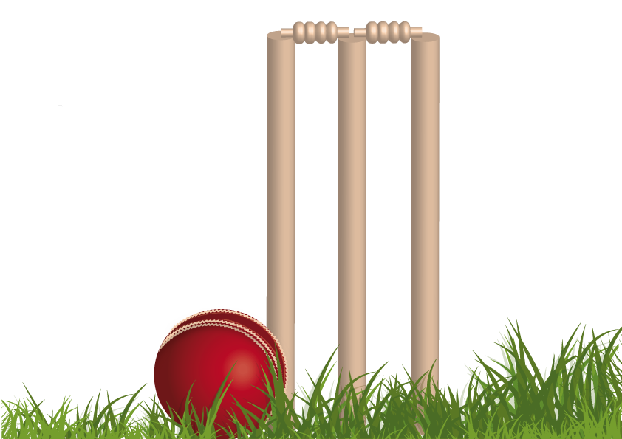
Source Data
Player name
Country name
Matches
Bat Innings
Bowl Innings
Not Outs
Fifities
Hundreds
Highest Score
Runs Scored
Batting Average
Runs conceded
Wickets
Bowling Average
Catches
Stumpings

Slide 6
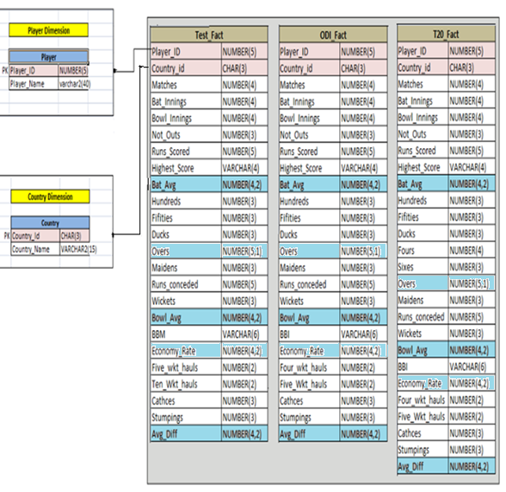
Data Warehouse Star Schema

Slide 7
Staging Tables
Conditional Split
(Source)
Expression
(Ltrim, RTrim)
Sort
Staging Area
Source
(Batting)
Source
(Batting)
Conditional Split
(Source)
Expression
(Ltrim, RTrim)
Sort
Staging Area
Source
(Bowling)
Conditional Split
(Source)
Expression
(Ltrim, RTrim)
Sort
Staging Area
Source
(Fielding)

Slide 8
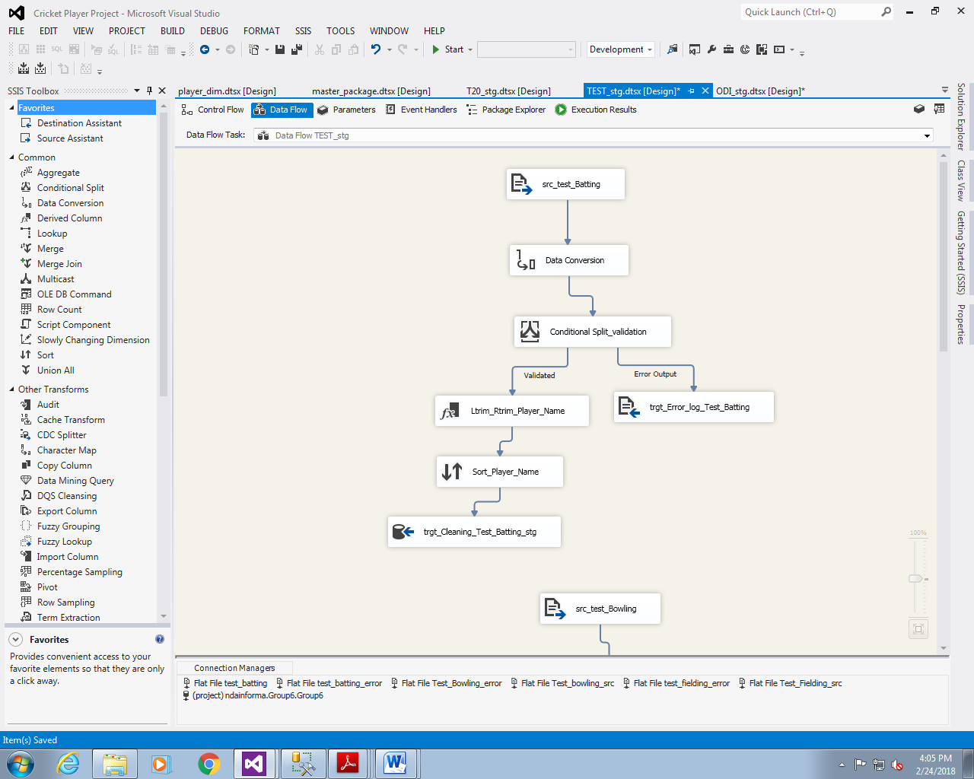

Slide 9
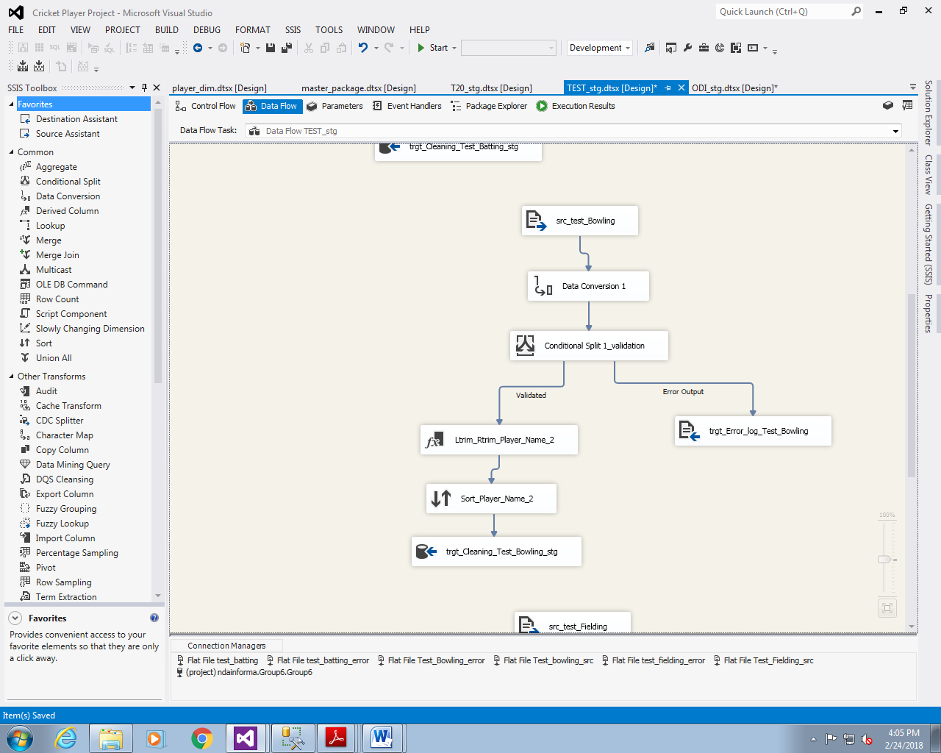

Slide 10
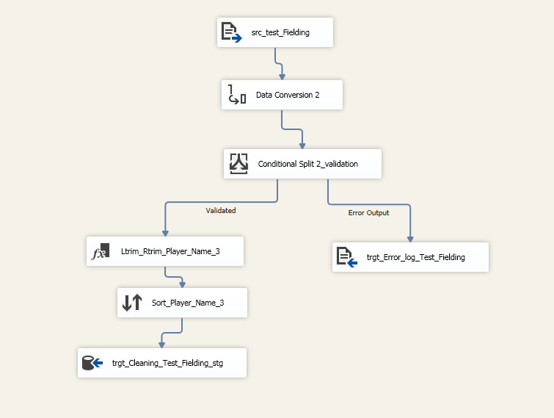

Slide 11
Data Combination for Batting, Bowling & Fielding
Only batting
Only Fielding
Batting
Bowling
(Lookup)
Fielding
(Lookup)
Bat and Bowl
Bat, Bowl and Field
Player Data
(All Combined)
Derived Column
Replace Nulls

Slide 12
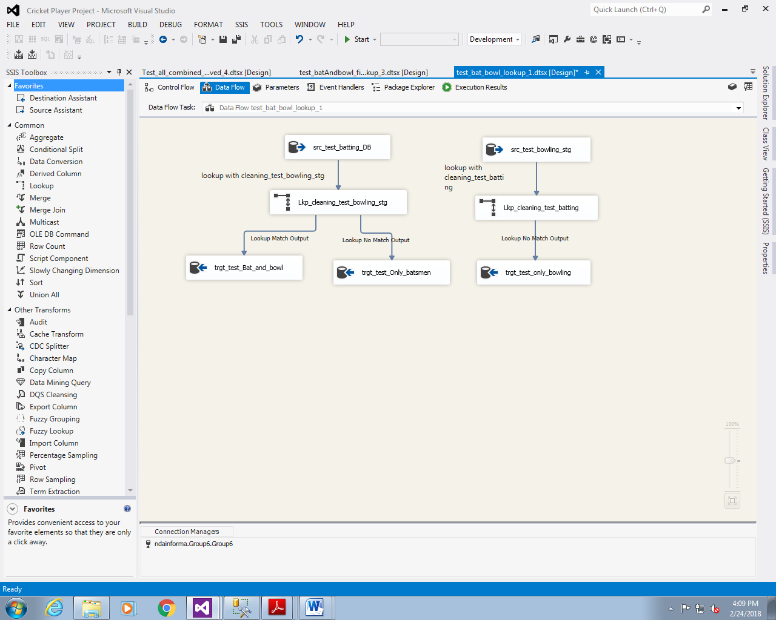

Slide 13
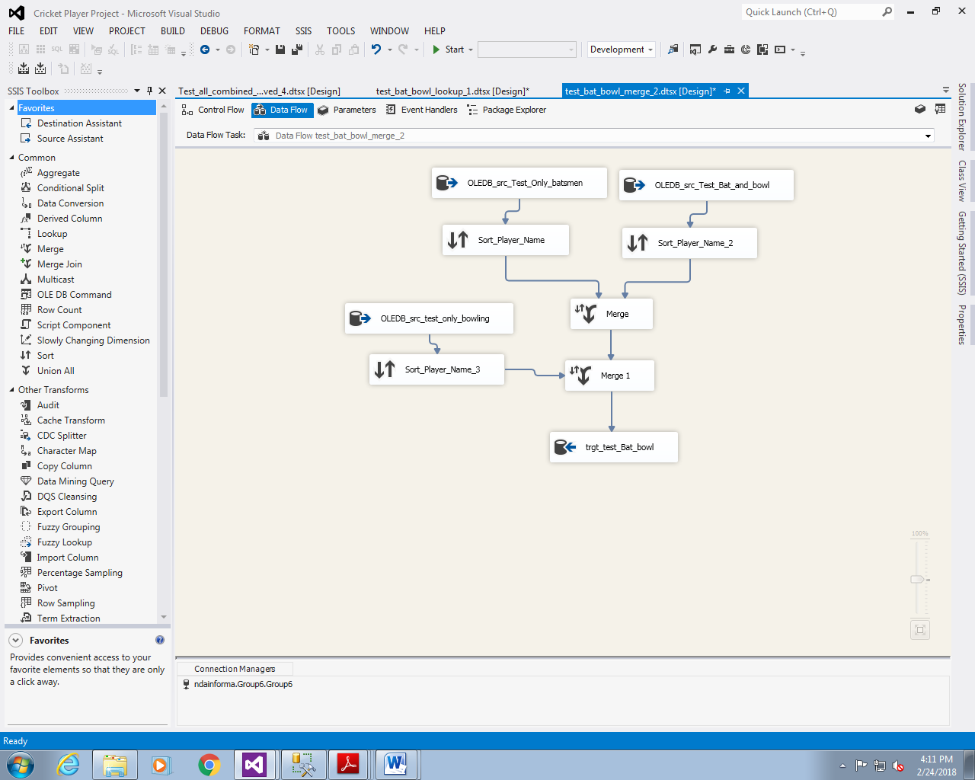

Slide 14
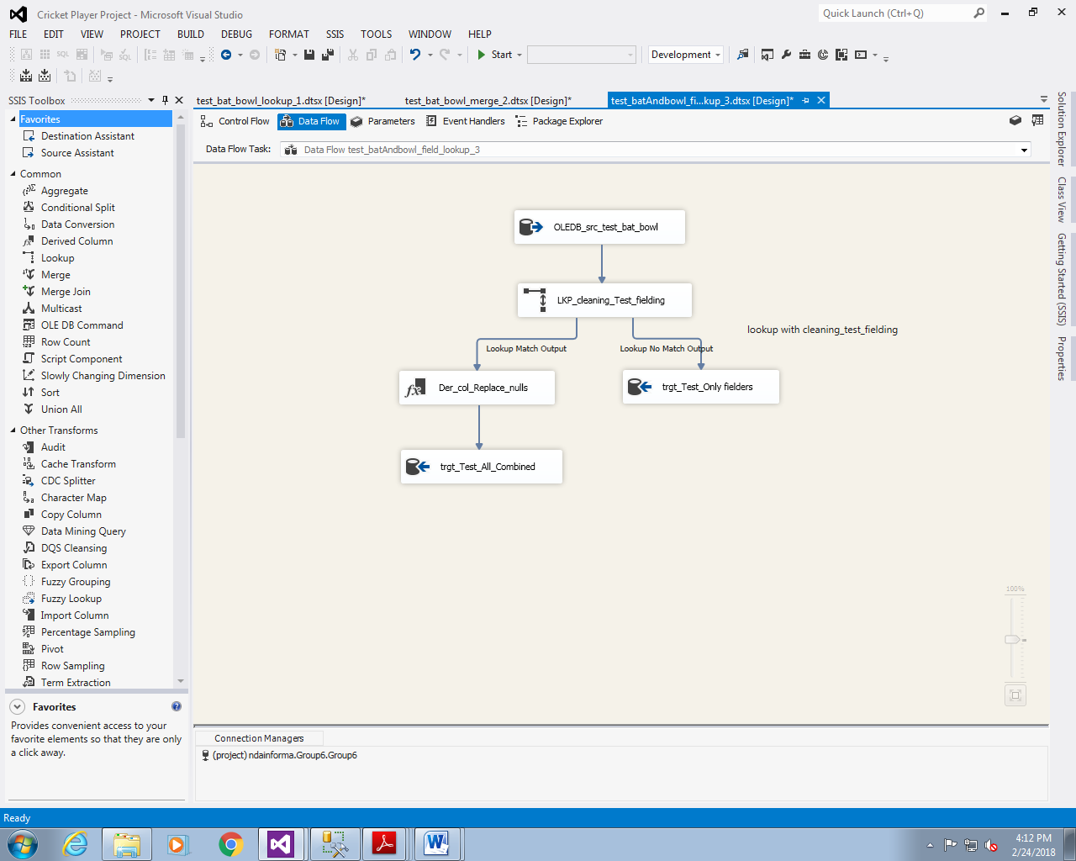

Slide 15
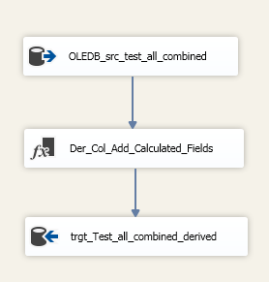
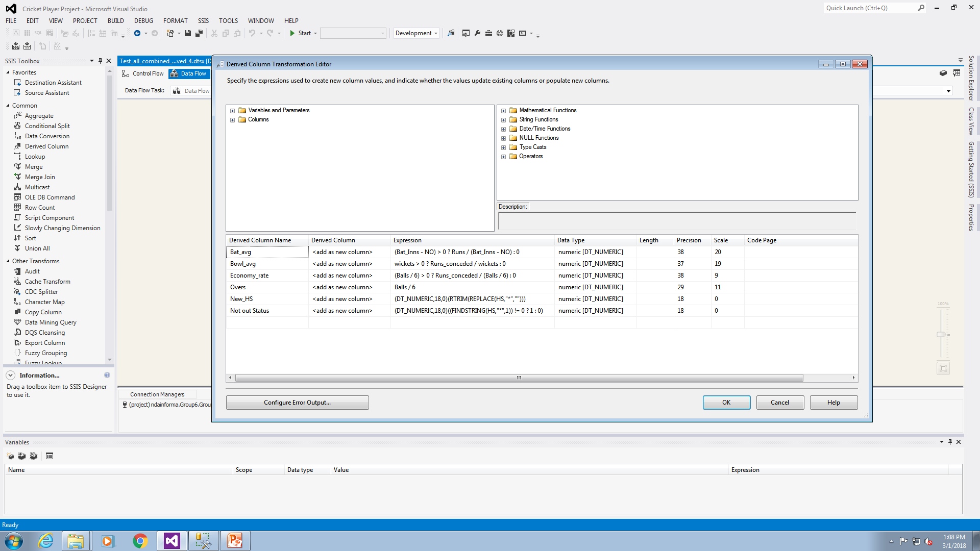

Slide 16
Creation of Player Dimension Table
OLEDB Cleaned Data Tables
(Source)
Player Dimension
T20 Merged Table
Test Merged Table
ODI Merged Table

Slide 17
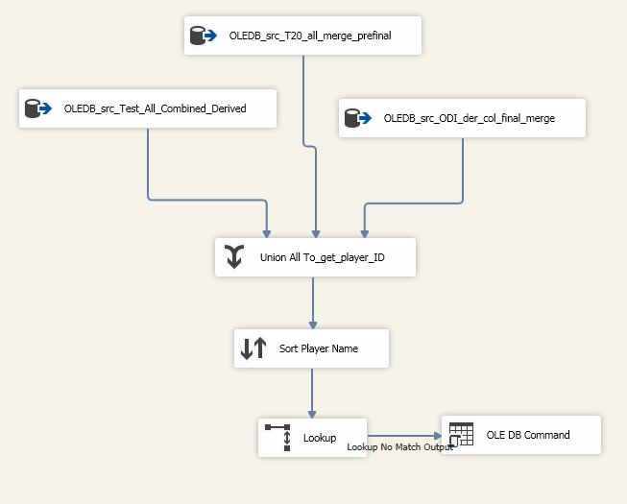

Slide 18
Populating Fact tables
Source
(Staging Area)
Test Fact
ODI Fact
T20 Fact
Player Dimension
(Lookup)
Country Dimension (Lookup)

Slide 19
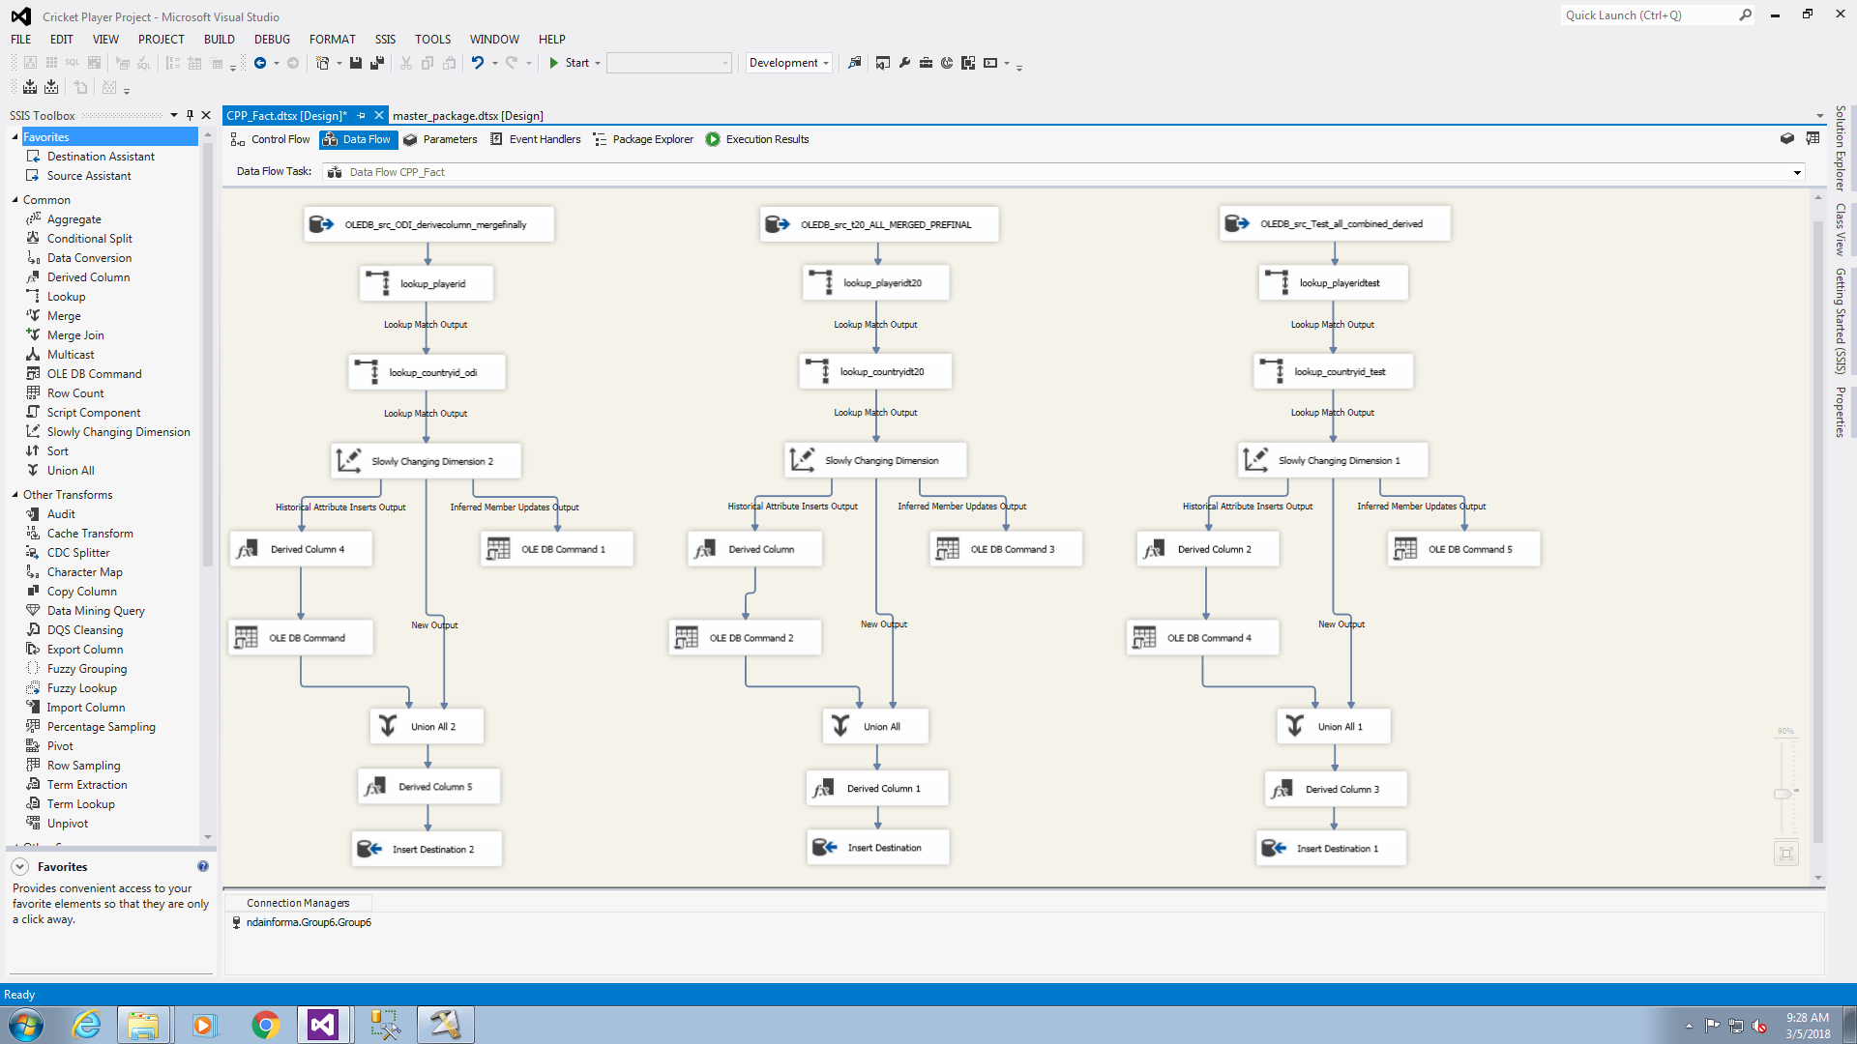

Slide 20
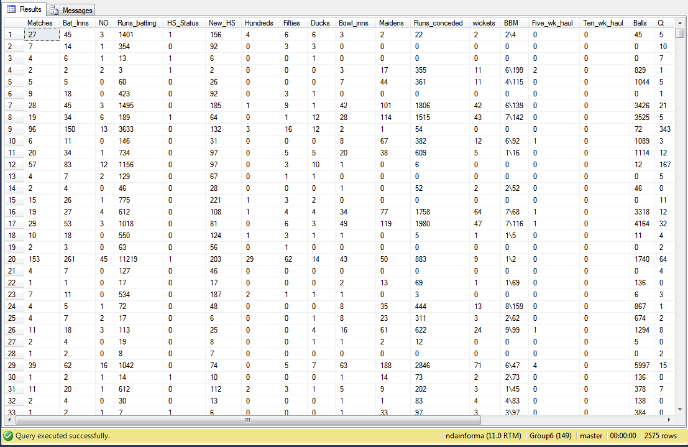
Fact table data

Slide 21
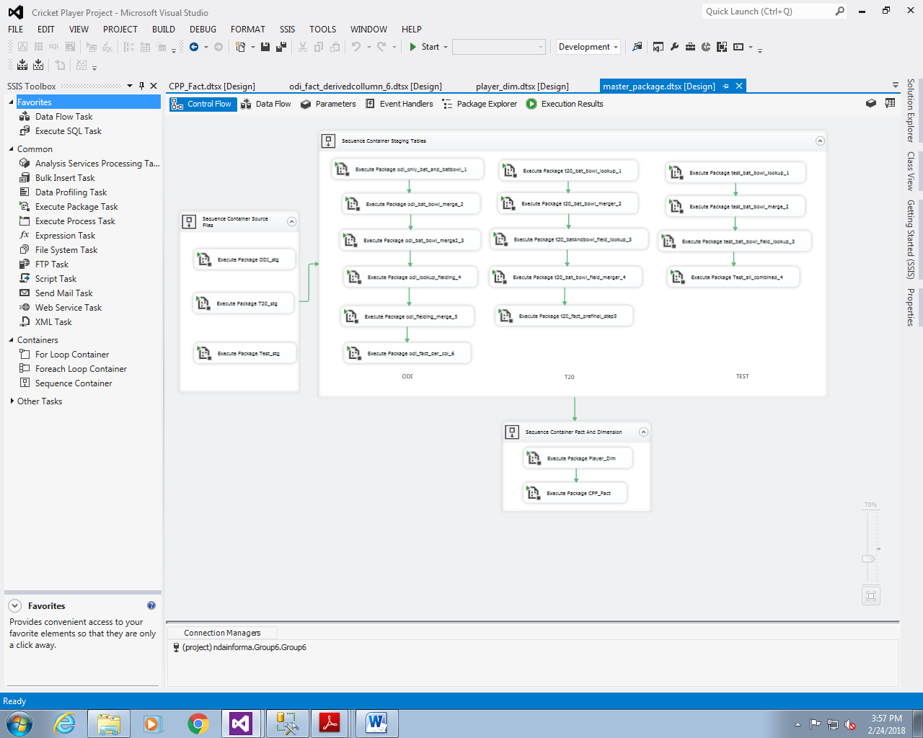
Automation

Slide 22
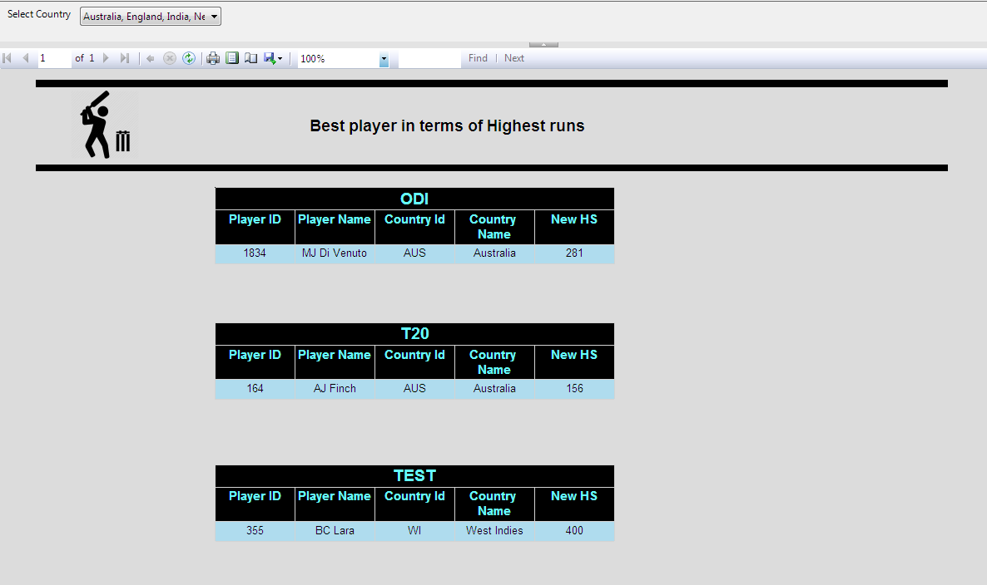
Cricket Performance Analysis Reports

Slide 23
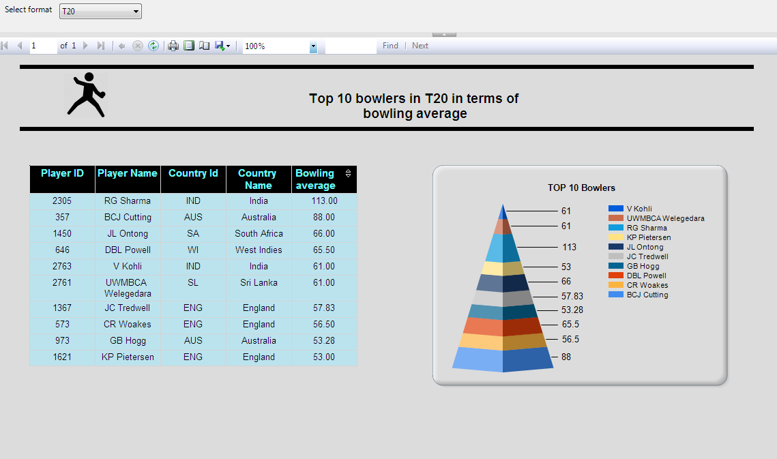

Slide 24
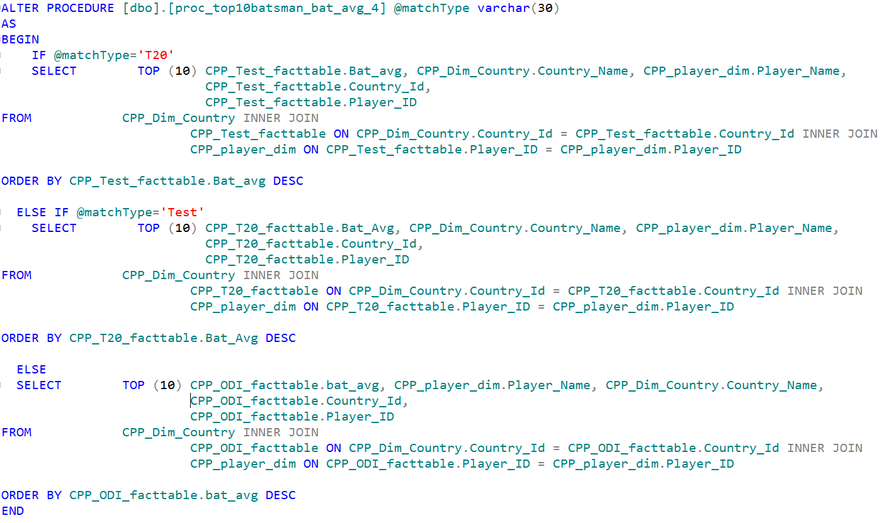
Stored Procedure for selecting dataset at Runtime

Slide 25
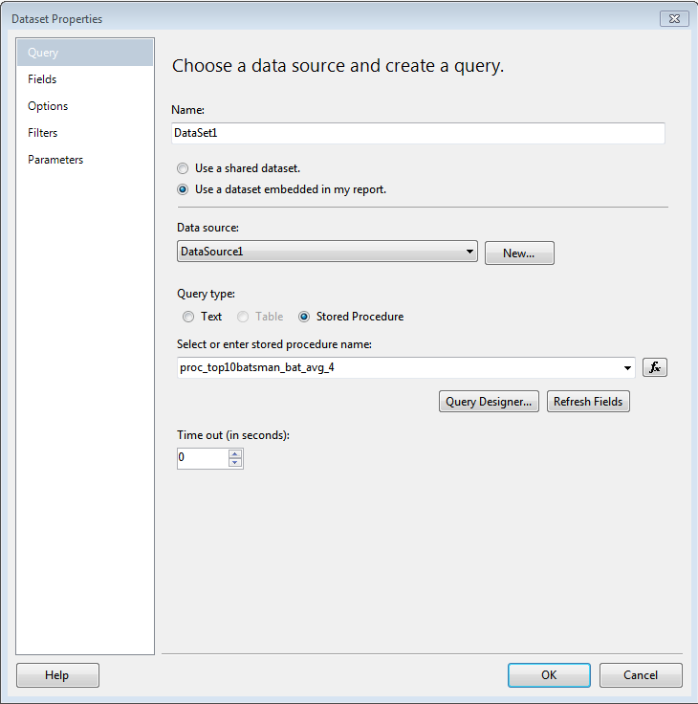

Slide 26
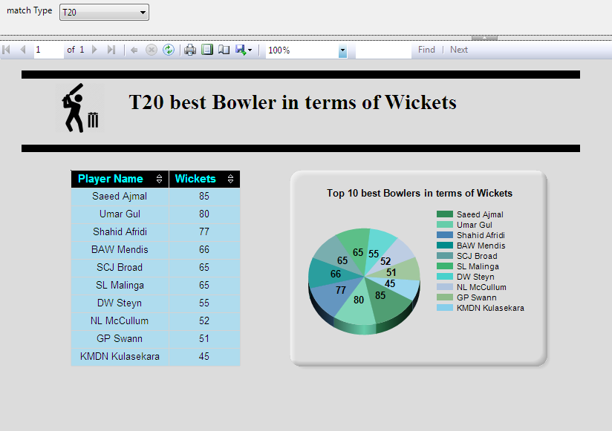

Slide 27
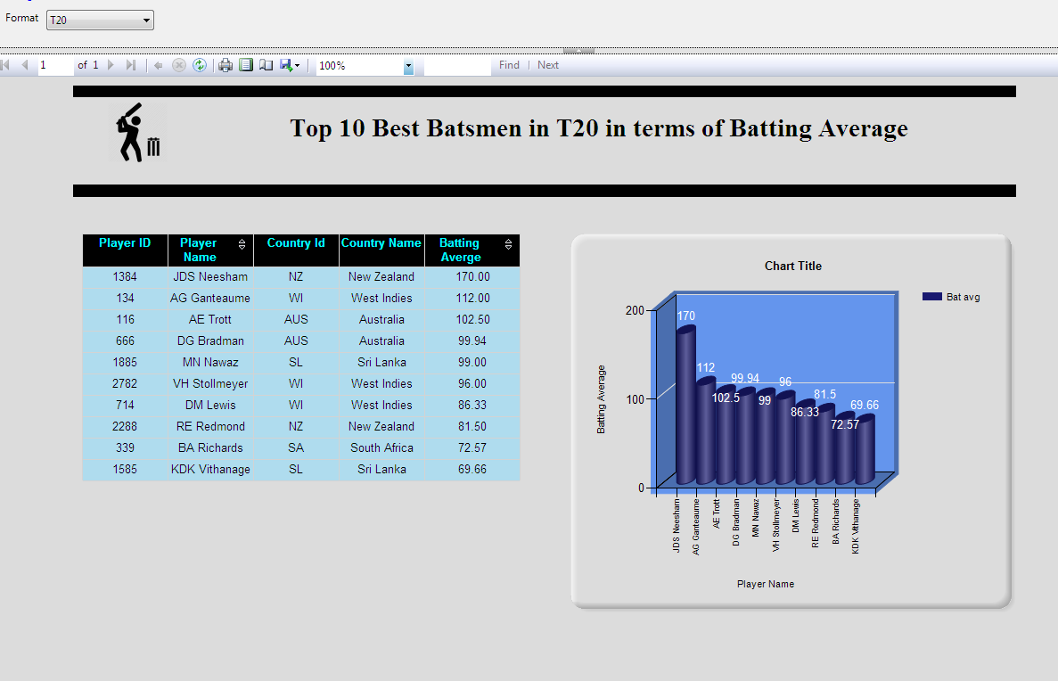

Slide 28
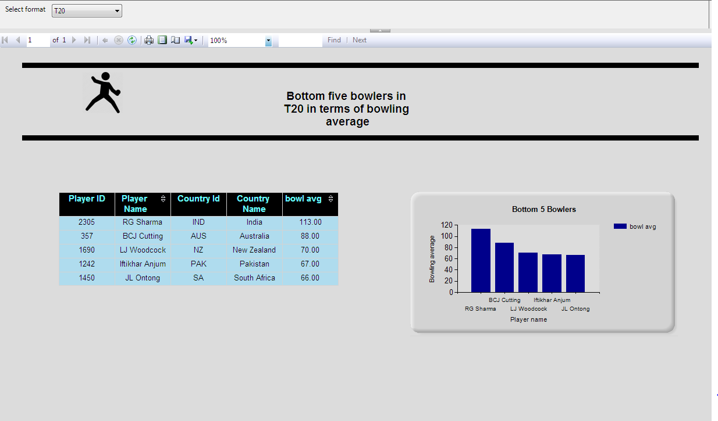

Slide 29


Any Queries?

Slide 30
Thank You

